Slide 1

Workshop
10/21/2021

Slide 2
Welcome!

Slide 3



Welcome Message from Host Rajeev Nalawadi and Intel
Products Link:
Intel® Products: Processors, Intel® NUC, Memory and Storage, Chipsets
Notes:
Looking forward to the day that we can have in person community workshops again.

Slide 4
Disclaimer
All workshop presentations, SIG/WG sessions will be recorded and made available publicly afterwards.

Slide 5
Logistics
Host of Zoom Meeting will share the slides on screen and record all presentations.
All participants will be muted except when presenting.
Questions should be posted in the Slack “onnx-general”
Please “raise hand” (Zoom feature) if you would like to speak and engage in the discussion.

Slide 6
Goals for the Workshop
Get the latest updates on ONNX - Processes, Roadmap Releases, and SIGs/WGs
Learn from the community and how ONNX is being used
Share feedback on what is working (and what isn’t)
Learn how to get more involved with ONNX Steering Committee, SIGs and Working Groups

Slide 7
Agenda -1
Rajeev Nalawadi (Intel) | Welcome Logistics Goals Agenda
Wenming Ye (Amazon) | State of the State: ONNX Growth & Governance
Alexandre Eichenberger (IBM) | Roadmap & Releases
8:00 | Welcome
8:05 | ONNX SC Updates
8:15 | Community Updates
10:10 | Break
10:10 | SIG Updates
11:00 | Wrap Up

Slide 8
Agenda - 2
Emma Ning (Microsoft) | ONNX Runtime Web: running your machine learning model in browser
Haixuan Xavier Tao ( Banque France) | ONNX as standard format for institution with legacy
Elpida Tzortzatos (IBM)& Andrew M. Sica (IBM) | ONNX and the AI on IBM Z client journey
Mengni Wang (Intel) | Intel® Neural Compressor: A Scalable Quantization Tool for ONNX Models
Zhipeng Huang (Huawei) | Ascend CANN and ONNX : inference interoperability for better performance
Kiefer Kuah (Intel) | Intel® OneAPI software stack: ONNX Support for xPU hardware
Ti Zhou (Baidu) | ONNX: Boosting PaddlePaddle Deployment in Industry
Sri Krishnamurthy (QuantUniversity) | Auditing considerations for ONNX models and benchmarking with QuSandbox
Jason Knight (OctoML) and Andrew Luo (OctoML) | TVM: Dynamic shapes, control flow, and quantization with a compiler
Sergey Lyalin (Intel) | Place of ONNX in OpenVINO ecosystem
Ashwini Khade (Microsoft) | Triton & ONNX Runtime:
8:00 | Welcome
8:05 | ONNX SC Updates
8:15 | Community Updates
10:10 | Break
10:10 | SIG Updates
11:00 | Wrap Up

Slide 9
Agenda - 3
8:00 | Welcome
8:05 | ONNX SC Updates
8:15 | Community Updates
10:10 | Break
10:10 | SIG & WG Updates
11:00 | Wrap Up
Ashwini Khade (Microsoft) | Architecture/Infrastructure SIG
Michał Karzyński (Intel) and Ganesan Ramalingen (Microsoft) | Operators SIG
Chin Huang (IBM) and Guenther Schmuelling (Microsoft) | Converters SIG
Wenbing Li & Mark Hamilton (Microsoft) | Model Zoo/Tutorials SIG
Joaquin Anton (Nvidia) | Pre-processing WG

Slide 10
State of the state
(Wenming Ye)

Slide 11
Engagement & usage (from 3/21/21 to 10/20/21)
15%
11%
16%
63%
6.8k
PRs
208
Contributors
11.6k
Stars
4165
Dependent Repos
16%
0%
41%
436%
2.2k
Forks
200
Papers
55
Models in Zoo
1.6m
Monthly Downloads
Notes:
Updated 10/20/2021 by W.Y.
From checking github.com - https://github.com/onnx/onnx
Stars: 11.5K from 9.9K (11500-9900)/9900
Used By: Dependent Repos: 4165 from 2550 (4165-2550)/2550
Contributors: 208 from 186 (208-186)/186
Forks 2.2K from 2.2K (2200-2200)/2200
PRs across all repositories ???? from 5931 (????-5931)/5931
Monthly Download 367K from 300K (366627-300000)/300000
From checking arxiv.og - http://search.arxiv.org:8081/?in=&query=onnx
Papers 200 from 200 (200-200)/200
From checking github – https://github.com/onnx/models
Count only the ones with model class hyperlink in first column
Models in Zoo 39 from 39 (39-39)/39
https://insights.lfx.linuxfoundation.org/projects/ - view 5 year
Pull Requests 6880 from 5954 (6880-5954)/5954

Slide 12
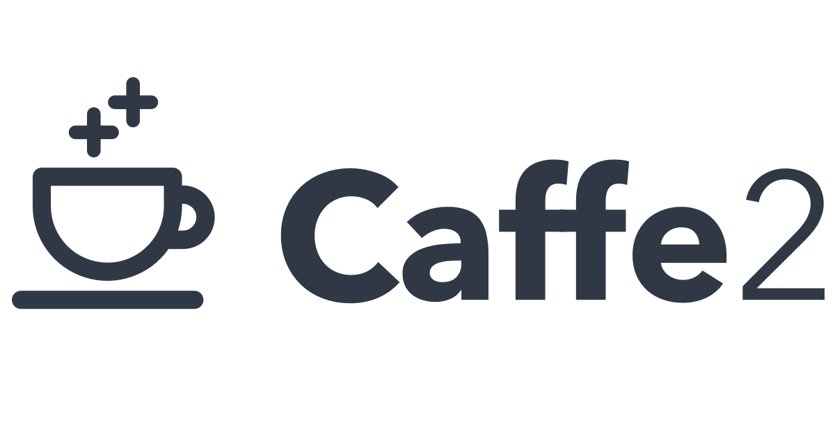































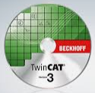






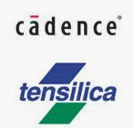













Tools (and Companies) that Support Onnx
Creation/
Manipulation
LibSVM
Run/
Compile
NNOIR
Visualization/ Test Tools

Slide 13

























Companies (Continued)

Slide 14
Governance

Slide 15
ONNX open governance update
Steering Committee
https://github.com/onnx/steering-committee
Prasanth Pulavarthi (MSFT)
Alexander Eichenberger (IBM)
Wenming Ye (Amazon)
Mayank Kaushik (Nvidia)
Rajeev Nalawadi (Intel)
Special Interest Groups (SIGs)
https://github.com/onnx/sigs
Architecture & Infra: Ashwini Khade, Ke Zhang
Operators: Michał Karzyński, Ganesan Ramalingam
Converters: Guenther Schmuelling, Chin Huang
Model Zoo & Tutorials: Wenbing Li
Pre-processing: Joaquin Anton

Slide 16
Call to Action!
Participation
Roadmap discussion
Slack Invitation
Q&A on Github
Contribution
Start with Documentation
Blogs – How are you and your customers using Onnx?
Talks by Community members

Slide 17
Roadmap
(Alexandre Eichenberger)

Slide 18
ONNX roadmap discussions
ONNX Roadmap Slack
onnx.ai website
Request for features
6 weekly
community
discussions
Presentations on selected topics:
12 presentations
Published video & presentations on Slack
Referral to appropriate SIGs for ongoing discussions & implemenation
Notes:
I will start with a brief recap of the roadmap discussion process that we shared in the last community workshop.
If you remember from the last workshop, we received a lot of feedback from community to come up with the roadmap ideas and spent about 6 weeks discussing the ideas and came up with the suggested list of features and their impact.

Slide 19
ONNX Roadmap Discussions (# 1 of 4)
Topics | arch infra | convert | model tutorial | oper | preproc | training | release | other
New operators for data processing to cover ML pipeline (1). |  |  |  | x | x
C API for C++ components of ONNX (to assist in wrapper for model checker functionality) (2). | x
Better support for emitting ONNX models from other languages beyond Python (3) | x
(1) Nakaike (IBM). “New preprocessing operators for Kagle pre-processing.”
(2) Pocock (Oracle). “C API to enables model checking and modifying”
(3) Pocock (Oracle). “Writing models from other languages (C#, Java)”

Slide 20
ONNX Roadmap Discussions (# 2 of 4)
Topics | arch infra | convert | model tutorial | oper | preproc | training | release | other
Add meta information in tensors (4). | x | x |  |  |  |  | x
E2E pipeline with ONNX operators (include Keras, TF, Scikit-learn/Spark pipeline preprocessing flows) using single graph (5). | x |  | x | x | x
Converters improvement suggestions (tensorflow-onnx, Keras2Onnx) for better graph optimizations (6). |  | x |  | x
(4) Croome (Greenwaves). “Converter robustness and usability of quantization from older models.”
(5) Sica (IBM). “Combine data processing and inference as part of a single model”
(6) Sica (IBM). “Converters targeting the higher functionality ops (e.g. LSTM/RNN/GRU)”

Slide 21
ONNX Roadmap Discussions (# 3 of 4)
Topics | arch infra | convert | model tutorial | oper | preproc | training | release | other
Address gaps with Opset conversions across broad set of models (7). | x | x |  |  |  |  | x
ONNX model zoo example for E2E distributed training scenario of large models (8). |  |  | x
Define concept of federated learning for ONNX (9). |  |  |  | x
(7) Sabharwal (Intel). “Converter robustness and usability of quantization from older models.”
(8) Esteves (Intel). “Distributed learning”
(9) Esteves (Intel). “Federated learning”

Slide 22
ONNX Roadmap Discussions (# 4 of 4)
Topics | arch infra | convert | model tutorial | oper | preproc | training | release | other
Improvements to shape inference implementation (10). | x
Introduce ONNX model provenance & security to safeguard against manipulations (11). | x |  | x |  | x | x |  | runtime
ONNX model zoo support for quantized and mixed precision models. (12) |  |  | x | x
(10) McCarter (Lightmatter). “Shapes with symbolic computations, unknown ranks.”
(11) Karumanchi et al (Intel & IBM + Oracle). “Meta data properties, from model to runtime, integrity”
(12) Karumanchi et al (Intel & IBM). “Meta data for models, ops with reduction type as an attribute?”

Slide 23
ONNX 1.10 Released
Release v1.10.0 · onnx/onnx (github.com)
ONNX v1.10 comes with several Key updates, IR Updates, Opset Version 15, API, Infrastructure, Bug fixes
Visit ONNX.AI website to learn more
Thank you everyone for your countless hours of work!

Slide 24
Questions?

Slide 25
Community
Presentations

Slide 26
Agenda - 2
Emma Ning (Microsoft) | ONNX Runtime Web: running your machine learning model in browser
Haixuan Xavier Tao ( Banque France) | ONNX as standard format for institution with legacy
Elpida Tzortzatos (IBM)& Andrew M. Sica (IBM) | ONNX and the AI on IBM Z client journey
Mengni Wang (Intel) | Intel® Neural Compressor: A Scalable Quantization Tool for ONNX Models
Zhipeng Huang (Huawei) | Ascend CANN and ONNX : inference interoperability for better performance
Kiefer Kuah (Intel) | Intel® OneAPI software stack: ONNX Support for xPU hardware
Ti Zhou (Baidu) | ONNX: Boosting PaddlePaddle Deployment in Industry
Sri Krishnamurthy (QuantUniversity) | Auditing considerations for ONNX models and benchmarking with QuSandbox
Jason Knight (OctoML) and Andrew Luo (OctoML) | TVM: Dynamic shapes, control flow, and quantization with a compiler
Sergey Lyalin (Intel) | Place of ONNX in OpenVINO ecosystem
Ashwini Khade (Microsoft) | Triton & ONNX Runtime:
8:00 | Welcome
8:05 | ONNX SC Updates
8:15 | Community Updates
10:10 | Break
10:10 | SIG Updates
11:00 | Wrap Up

Slide 27
SIG
Presentations

Slide 28
Agenda - 3
8:00 | Welcome
8:05 | ONNX SC Updates
8:15 | Community Updates
10:10 | Break
10:10 | SIG & WG Updates
11:00 | Wrap Up
Ashwini Khade (Microsoft) | Architecture/Infrastructure SIG
Michał Karzyński (Intel) and Ganesan Ramalingen (Microsoft) | Operators SIG
Chin Huang (IBM) and Guenther Schmuelling (Microsoft) | Converters SIG
Wenbing Li (Microsoft) & Mark Hamilton (Microsoft) | Model Zoo/Tutorials SIG
Joaquin Anton (Nvidia) | Pre-processing WG

Slide 29
Wrap up!

Slide 30
Wish we had more time!

Slide 31
Thank you ...
Recording of today’s workshop and other applicable content will be shared via ONNX-Announce mailing list when available.
Please stay engaged and continue to contribute to ONNX and ONNX related projects.
Remember to use the following ONNX resources:
Website: https://onnx.ai/
GitHub: https://github.com/onnx
Slack: (join https://slack.lfai.foundation - email, password, then find onnx-general)
Calendar: https://onnx.ai/calendar
Mailing List: https://lists.lfai.foundation/g/onnx-announce

